Slide 1
Density Functional Theory
1. Clamped approximation
2. Independent electrons approximation
Summary
Magnetic
Structure
Electronic
Junfei Ding 06-Sep-2020

Slide 2
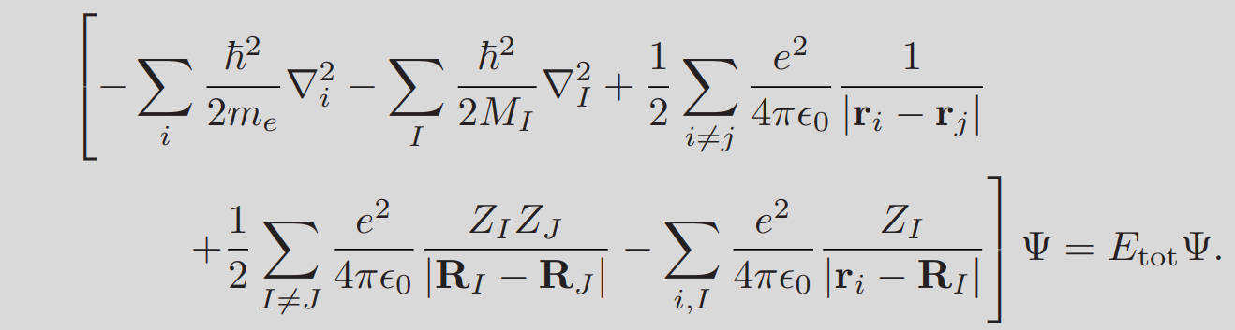
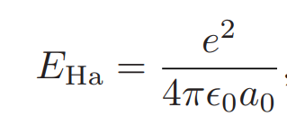
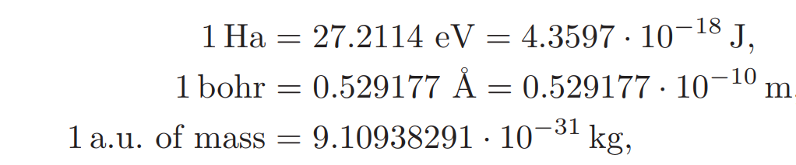
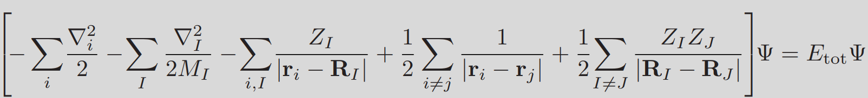
MSE in Hartree unit
Summary
Magnetic
Structure
Electronic

Slide 3
Clamped nuclei approximation
In the case of solids, the nuclei are so heavy that in practice they cannot move.
Therefore we can set $M_{I}=∞$in MSE.
Therefore we can set 𝑀_𝐼=∞ in MSE.
This choice implies that we can neglect the kinetic energy of the nuclei in MSE
And that the Coulomb repulsion between nuclei is simply a constant
Summary
Magnetic
Structure
Electronic

Slide 4
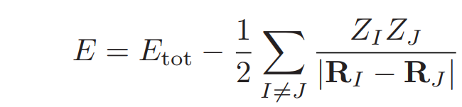
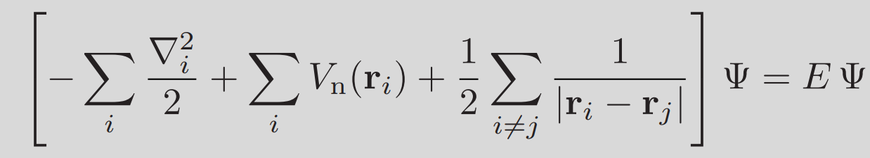
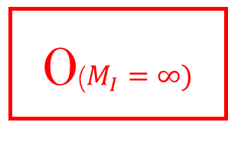
Clamped nuclei approximation
0($M_{I}=∞)$
Summary
Electronic
Magnetic
Structure
This is the fundamental equation of electronic structure theory.

Slide 5
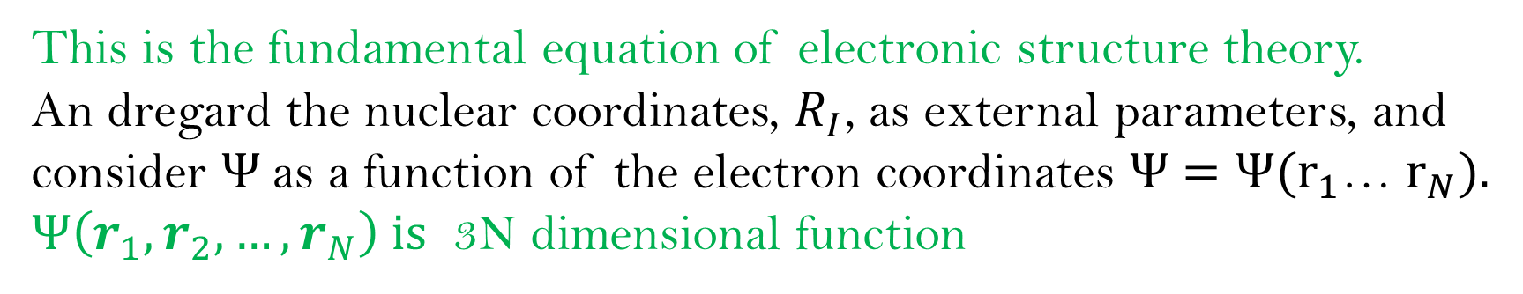

Many-body Schr$\ddot{o}$diner equation
Summary
Magnetic
Structure
Electronic
This is the fundamental equation of electronic structure theory.
An dregard the nuclear coordinates, $R_{I}$, as external parameters, and consider $Ψ$as a function of the electron coordinates Ψ $=\text{Ψ}(r_{1}$… $r_{N}).$
$Ψ\left(r_{1},r_{2},…,r_{N}\right) is$ 3N dimensional function

Slide 6
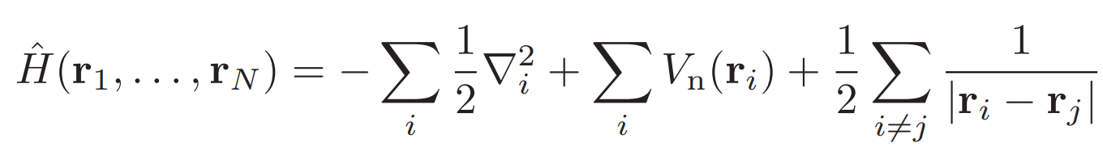
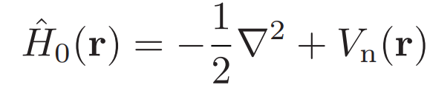
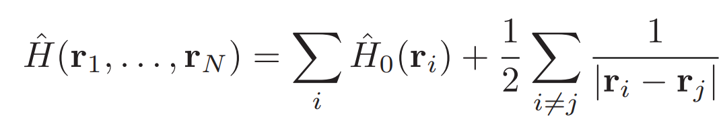
Independent electrons approximation
We define the many-electron Hamiltonian:
It is natural to define the single-electron Hamiltonian:
Summary
Magnetic
Structure
Electronic
So that we can break up the many-electron Hamiltonian as follows:

Slide 7
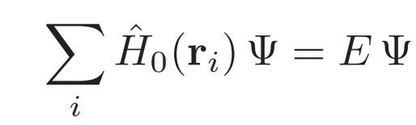
Independent electrons approximation
Summary
(1)
Magnetic
Structure
Electronic
If the electrons have no interaction with each other, then this term were absent.

Slide 8
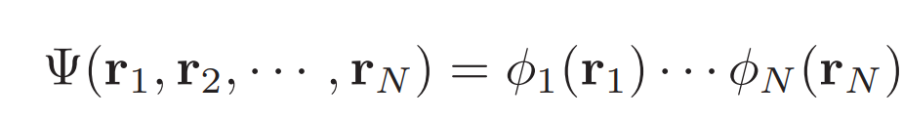
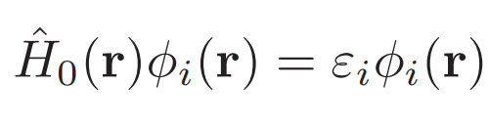
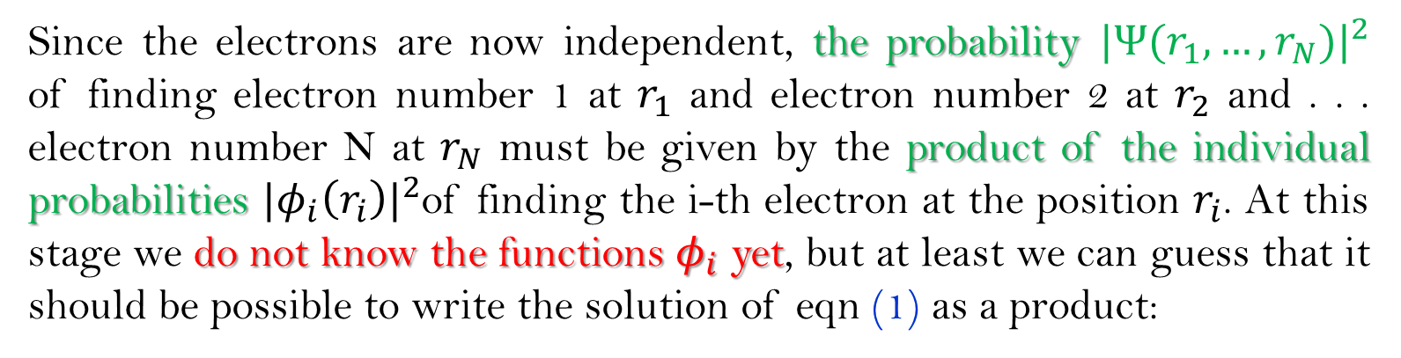
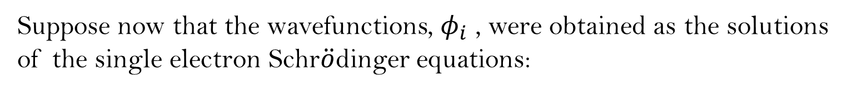
Independent electrons approximation
Since the electrons are now independent, the probability ${|Ψ(r_{1},…,r_{N})|}^{2}$ of finding electron number 1 at $r_{1}$ and electron number 2 at $r_{2}$ and . . . electron number N at $r_{N}$ must be given by the product of the individual probabilities ${{|φ}_{i}\left(r_{i}\right)|}^{2}$of finding the i-th electron at the position $r_{i}$. At this stage we do not know the functions $φ_{i}$ yet, but at least we can guess that it should be possible to write the solution of eqn (1) as a product:
Summary
Magnetic
Structure
Electronic
(2)
Suppose now that the wavefunctions, $φ_{i}$ , were obtained as the solutions of the single electron Schr$\ddot{o}$dinger equations:
(3)

Slide 9
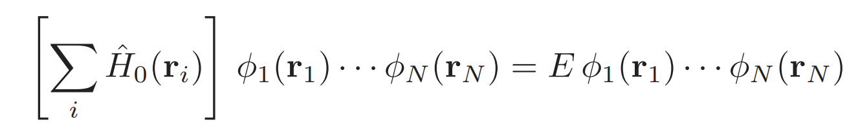
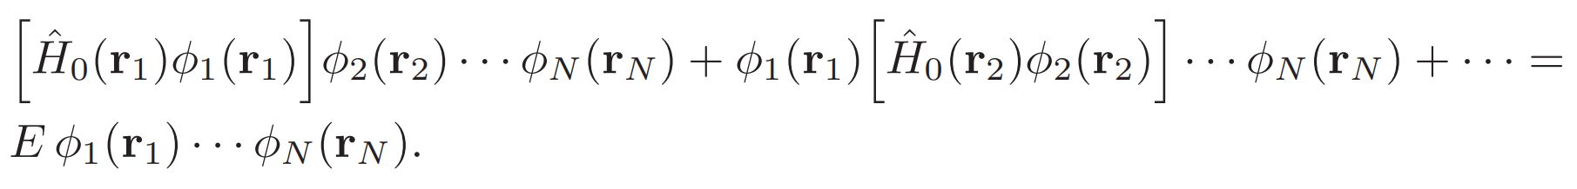
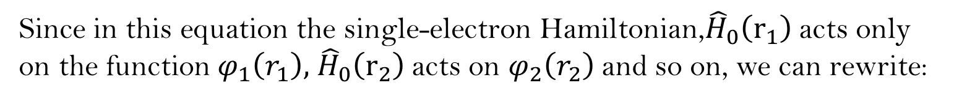
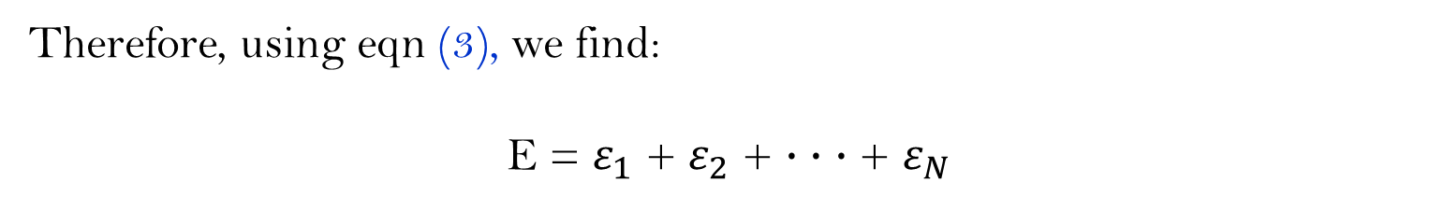
Independent electrons approximation
Replace the trial solution of eqn (2) inside eqn (1):
Since in this equation the single-electron Hamiltonian,${\hat{H}}_{0}\left(r_{1}\right)$acts only on the function $φ_{1}\left(r_{1}\right),$ ${\hat{H}}_{0}\left(r_{2}\right)$acts on $φ_{2}\left(r_{2}\right)$and so on, we can rewrite:
Summary
Magnetic
Structure
Electronic
Therefore, using eqn (3), we find:
E = $ε_{1}$ + $ε_{2}$ + · · · + $ε_{N}$

Slide 10

Independent electrons approximation
The independent electrons approximation carries two important drawbacks.
The first relates to the fact that the wavefunction, Ψ, should obey Pauli’s exclusion principle, which requires that the function changes sign whenever we exchange two electrons, e.g. if we swap $r_{1}$and $r_{2}$. In general, eqn $Ψ(r_{1},…,r_{N})$= $φ_{1}\left(r_{1}\right)$ ... $φ_{N}\left(r_{N}\right)$does not obey this rule.
The second problem is that the Coulomb term eliminated is actually of the same magnitude as the other terms, and therefore it cannot be ignored.
Summary
Magnetic
Structure
Electronic

